Slide 1

DATA SCIENCE PRESENTATION
Presetented by:
Rishab Kumar
Sujit Kumar
Saurabh Kumar
Abhikhek Roshan
Kumar Shanu

Slide 2

To be continue:
Data Science :
Supervised and Unsupervised Learning
Regression and Classifications
Linear and Multinomial
Logistic Regression and Multinomial Regression

Slide 3
To be continue:
Analytics problem statements with the helps of linear regresssion

Slide 4
To be continue:
Coding for Linear Regression

Slide 5
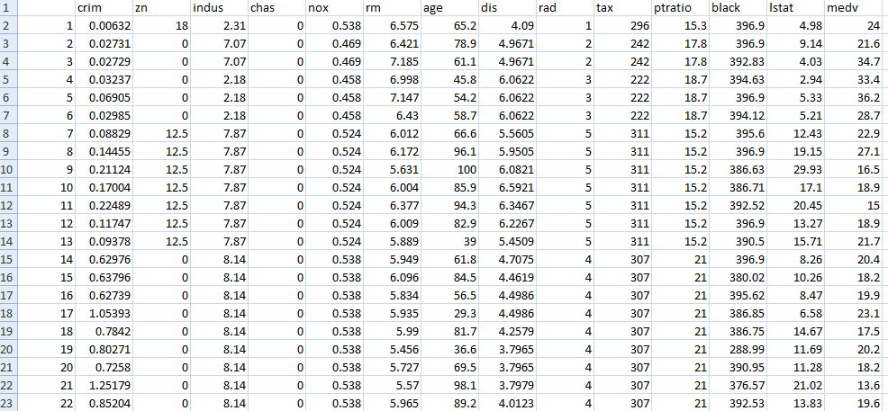

Slide 6
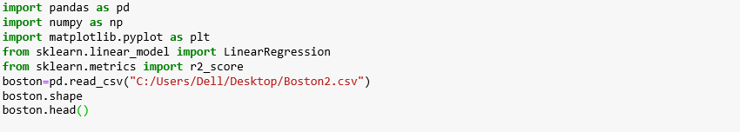
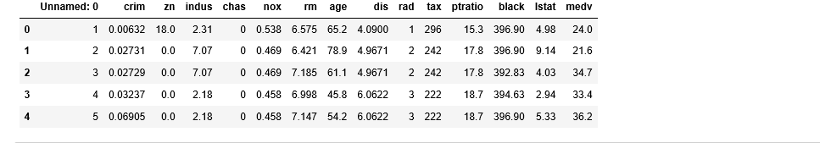
To be continue:

Slide 7
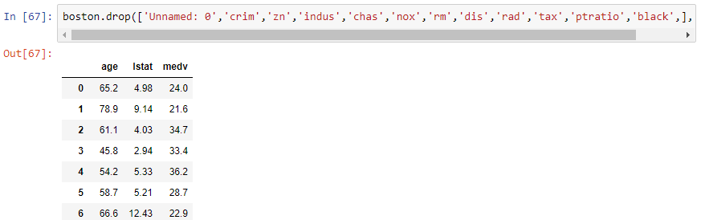
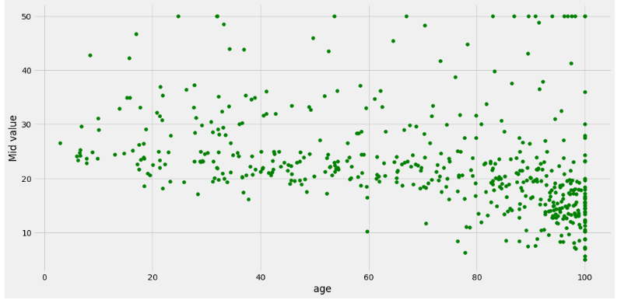
To be continue:

Slide 8
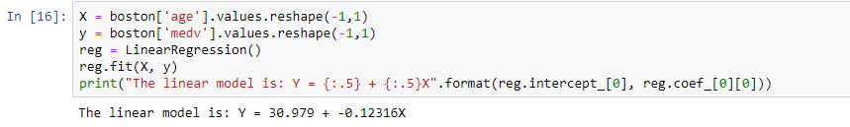
To be continue:

Slide 9
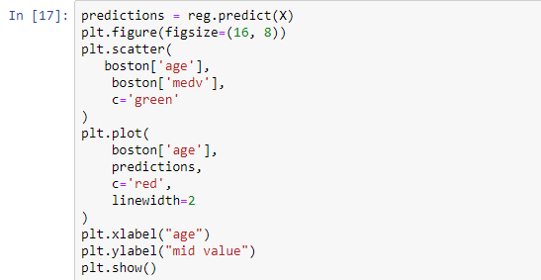
To be continue:

Slide 10
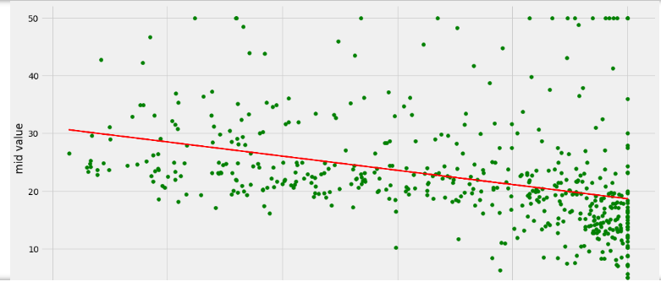
Result:

